Slide 1
Unit III Tourism

Slide 2
In 1976, the Tourism Society of England defines tourism as “Temporary short term movement of people to destination outside the places where they normally work and live and their activities during the stay at each destinations.
Three major aspects:
Leisure
Pleasure
Recreations

Slide 3
Typology (Classification)of tourism
Domestic tourism= Visiting tourists destinations within the country of residence.
Inbound tourism= Tourism from one country to another country where none of the countries is a resident country. E.g. Citizens of India going on a world tour where they travel from one to another country besides India.
Outbound tourism= Tourism to another country besides the residing country. E.g. Residents of India visiting Dubai

Slide 4
On the basis of region
Internal tourism= movement within country
National tourism= movement between countries
International tourism= tourism within the countries

Slide 5
On the basis of purpose
Ecotourism
Religious tourism
Adventure/Sports tourism
Beach tourism
Cultural tourism
Wildlife / Nature tourism
Medical tourism
Educational tourism
Rural tourism
Industrial
Geotourism
Fashion tourism
Music cruise
Sustainable tourism

Slide 6
Dark tourism
Historical tourism
Disaster tourism
Slum tourism
Suicide/ War tourism Business tourism
Island tourism
Coastal tourism
Yoga tourism

Slide 27
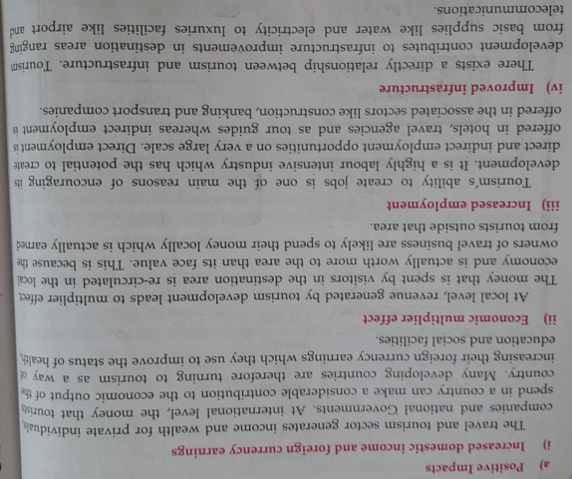

Slide 35
Impact on environment

Slide 37
Ecotourism

